Slide 1

Embedded Systems Design and Implementation GAME: TIC – TAC - TOE
by
Rabert Rajesh Mallavarapu.
14-06-2023, Bolzano.

Slide 2
Visual Studio Solution
The solution consists of
Main.cpp
Where game logic is defined
Canvas.cpp
Where functions to create, configure, update and reset a window are declared.
Canvas.h
Where global variables and functions are declared.

Slide 3

Board Setup
RESOLUTION_X = 8
RESOLUTION_Y = 8
Pixels[8][8]
Pad[3][3]

Slide 4

Player Setup
Player A – Square
Pixels[xPad][yPad] = 1
Pixels[xPad+1][yPad] = 1
Pixels[xPad][yPad+1] = 1
Pixels[xPad+1][yPad+1] = 1
Player B – Diagonal
Pixels[xPad][yPad] = 1
Pixels[xPad+1][yPad+1] = 1

Slide 5

Move Tile
xPad = {0,3,6}
yPad = {0,3,6}
left = A Pressed
xPad -= 3
Down = S Pressed
yPad += 3
Up = W Pressed
yPad -= 3
Right = D Pressed
xPad += 3
Enter Pressed = set Tile

Slide 6
Game Play
Total chances per game = 9
Odd - player one - 5 plays
Even - player two - 4 plays
Check winner after 5 plays
Winner != 0
Show winning Sequence
Show winner
Show Score Board
Play 5 Games for a tournament

Slide 7

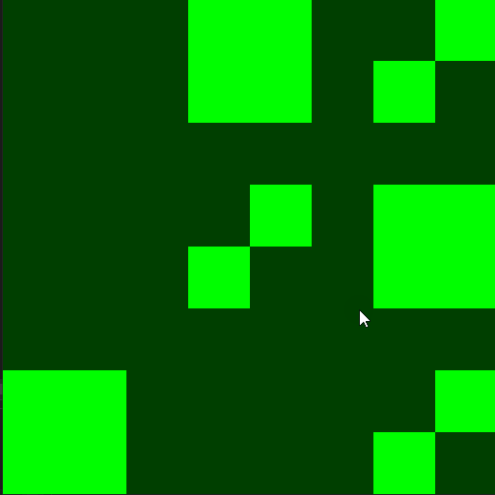
Game Play
Blink
Show Post

Slide 8

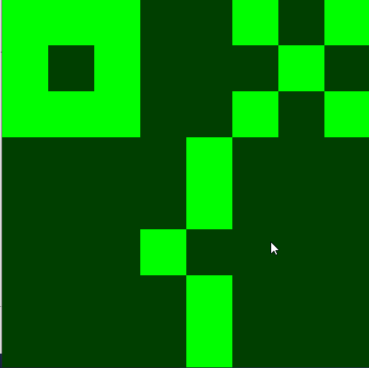
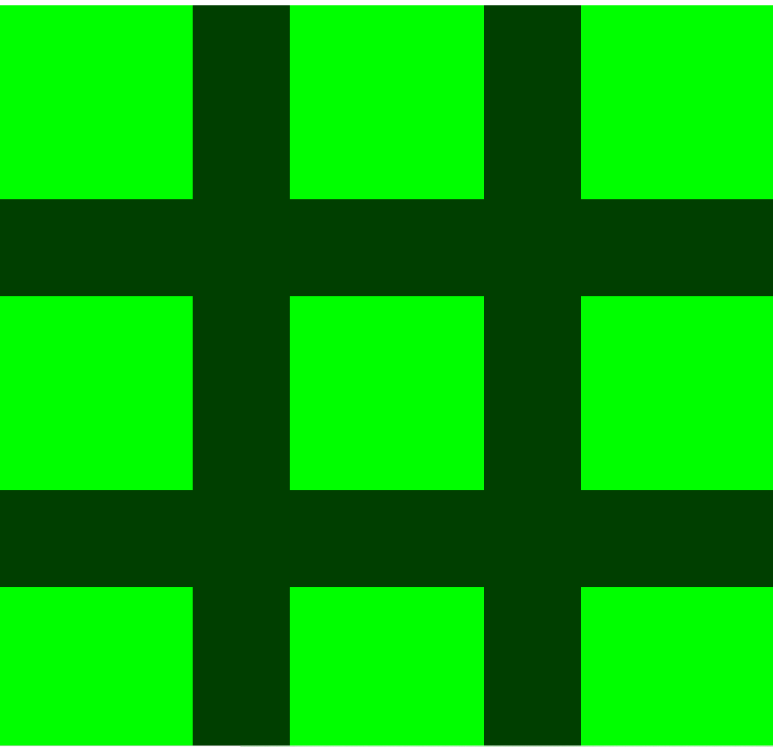
Winner and ScoreBoard

Slide 9
Tic-Tac-Toe Circuit on Arduino
Bill Of Materials
Items | Quantity
Buttons | 5
Active Buzzer | 1
Bread Board | 1
Arduino uno | 1
LED Matrix | 1
Red LED | 1
Green LED | 1
Yellow LED | 1
Resistors(250-330 ohms) | 8
optional potentiometer | 1
 | INPUTS
 | OUTPUTS

Slide 10
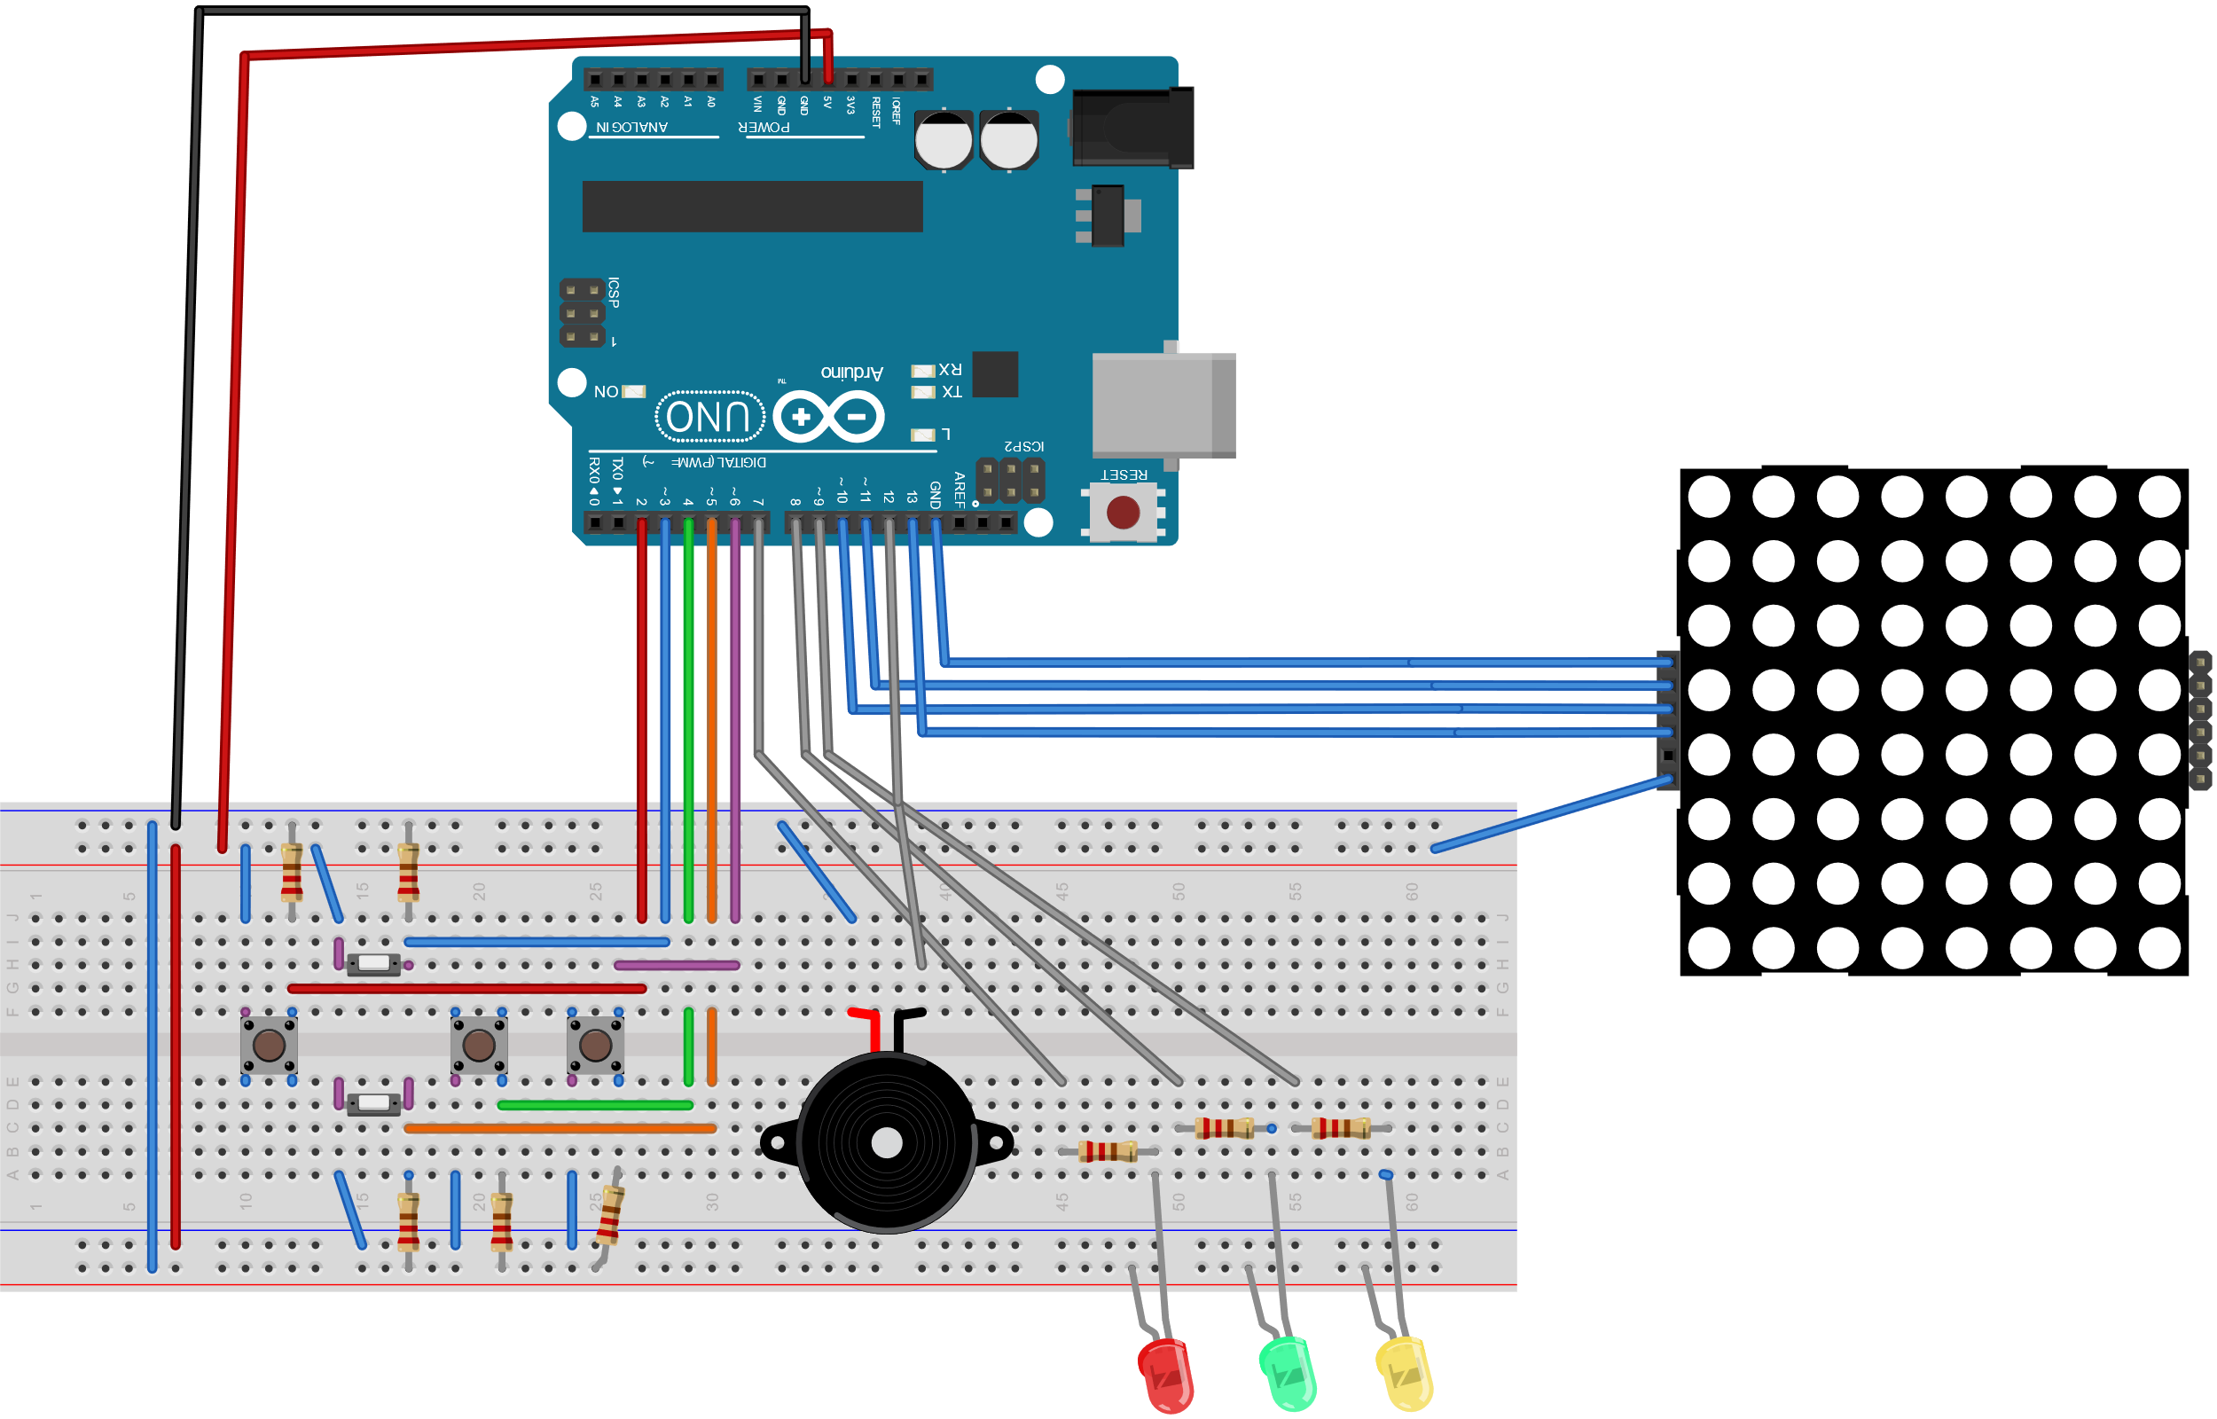
Schematic of Circuit for Arduino
Buttons
Left – Up – Right – Down – Enter = {2:6}
LED’s
Red – Green – Yellow = {7-9}
Buzzer = 12
LED Matrix
Clk – CS – DIN = {13, 10, 11}

Slide 11

Arduino Solution
A typical Arduino solution consists of :
Variable declaration
Setup ; one time initialization of functions/variables.
Loop; the program that is run repeatedly
Custom Functions.
The Arduino solution rely on the same functions developed in the VS.

Slide 12
Arduino Solution
The custom functions developed could be divided into three types:
Initialize and Reset Variables
InitPixels, InitPad, Boardinit, Gameinit.
Read variables and update Game
UpdatePixels, buttonDebug, DrawPad, CheckPad, Blink, CheckWinner, ScoreKepper.
Display game results
showPost, ShowWinner, ShowScore, ShowCredits.

Slide 13

Custom Functions
UpdatePixels
Sets pixel of the ON/OFF using mx.setpoint( x, y, 0/1)
A variation UpdateIntensity takes input (0-1) to set brightness of the pixels.
ButtonDebug
Sets the Yellow LED and Buzzer to HIGH if any button is HIGH.
ShowCredits
Uses Md.Parola to write a message to the led matrix, e.g.: “Winner – A – New Game ? “

Slide 14
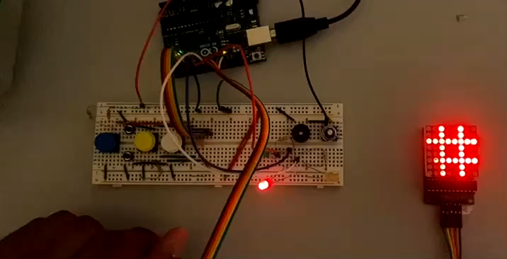
Video Presentation

Slide 15
THE END
THANK YOU !
QUESTIONS ?

